Slide 1

GEMINI LANDMARK DESCRIPTION APP
Enhancing Tourist Experiences with AI

Slide 2
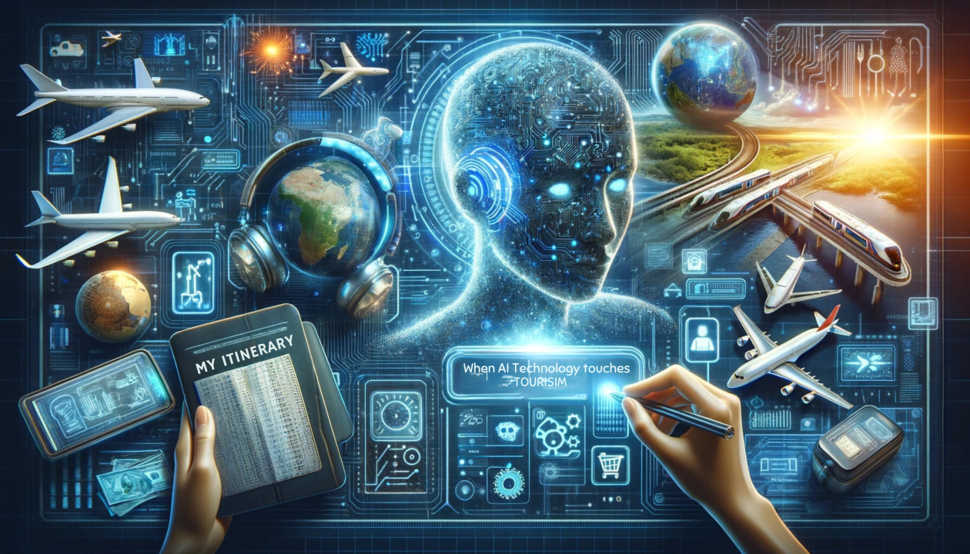
Introduction
The Gemini App uses AI to provide real-time landmark descriptions, translations, and interactive experiences for tourists.

Slide 3
Challenges in Tourism
• Lack of detailed landmark information
• Language barriers
• Difficulty in accessing historical facts
• Inefficient navigation

Slide 4
What is the Gemini Landmark Description App?
An AI-powered app that provides:
Real-time descriptions
AR-based visual storytelling
Voice translations
Personalized tour recommendations

Slide 5
Key Features
• AI-powered landmark recognition
• Multilingual support
• Augmented Reality (AR) integration
• Interactive storytelling
• Offline accessibility

Slide 6

How AI Enhances Tourist Experiences
• Automated landmark identification
• Instant historical facts & cultural insights
• Voice-guided navigation
• Personalized suggestions based on interests

Slide 7
User Experience Flow
1. Open the app and scan a landmark
2. AI provides real-time descriptions
3. AR overlays offer a rich experience
4. Users can hear translations in their language
5. Personalized recommendations for nearby attractions

Slide 8
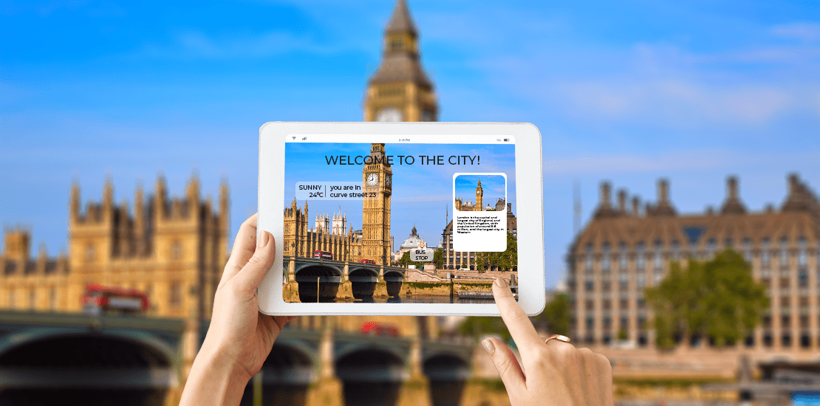
Benefits for Tourists
• Enhanced cultural understanding
• Overcomes language barriers
• Personalized and immersive experiences
• Saves time and effort

Slide 9
Impact on the Tourism Industry
• Boosts engagement at historical sites
• Increases revenue for tourism sectors
• Attracts tech-savvy travelers
• Promotes cultural preservation

Slide 10
Future Developments
• AI-driven interactive holograms
• Blockchain-based travel rewards
• Enhanced AR/VR integrations
• Smart itinerary planning using AI

Slide 11
Conclusion
The Gemini Landmark Description App revolutionizes tourism with AI, making travel more informative, accessible, and engaging.

